Slide 1
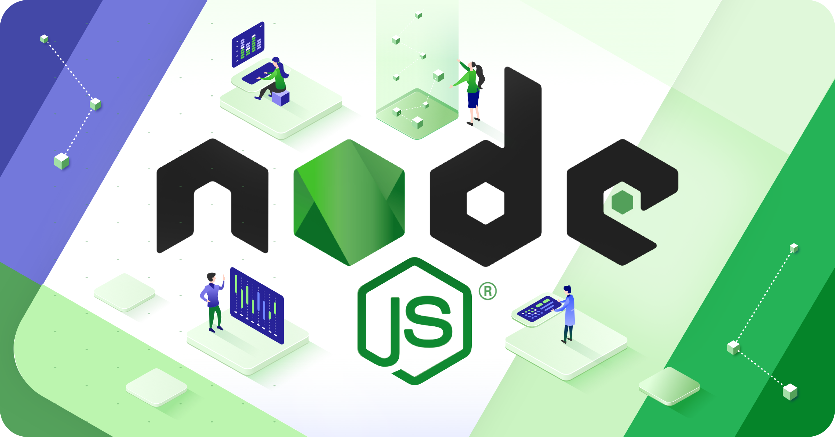

Slide 2
About Today…
Node.js installation
VSCode installation
Writing first node.js program

Slide 3
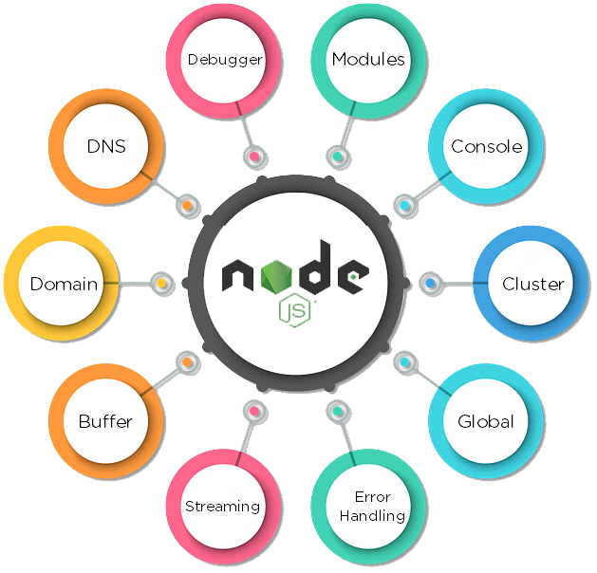
What is Node.js?
Node.js is an open-source, cross-platform JavaScript runtime environment that executes JavaScript code outside of a web browser

Slide 4
Key features of data handling
Asynchronous and event-driven nature for handling concurrent operations efficiently
Non-blocking I/O operations ideal for data-intensive tasks like file reading/writing, database operations, and API calls
V8 JavaScript engine for fast code execution
Large ecosystem of npm modules for data processing, analysis, and visualization

Slide 5
Ecosystem for Data Processing
Access to thousands of reusable packages for data-related tasks (e.g., data parsing, manipulation, storage, visualization)
csv-parser
Parse CSV data into JSON format for easy manipulation
moment
Date and time manipulation for data timestamp handling
express
Framework for building RESTful APIs to serve and consume data
chart
Data visualization library for creating interactive charts and graphs

Slide 6
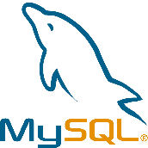




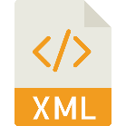

Why Choose Node.js
Access to thousands of reusable packages for data-related tasks (e.g., data parsing, manipulation, storage, visualization)
Scalability
Ability to handle large volumes of data and concurrent requests
Performance
Efficient handling of I/O-bound tasks without blocking the event loop
Support
Data visualization library for creating interactive charts and graphs
Flexibility
Seamless integration with various databases and data formats

Slide 7
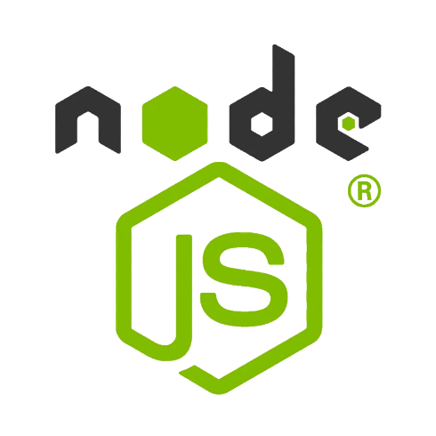
Setting Up Environment
Download the Node.js installer from the official website.
Run the installer and follow the installation instructions

Slide 8
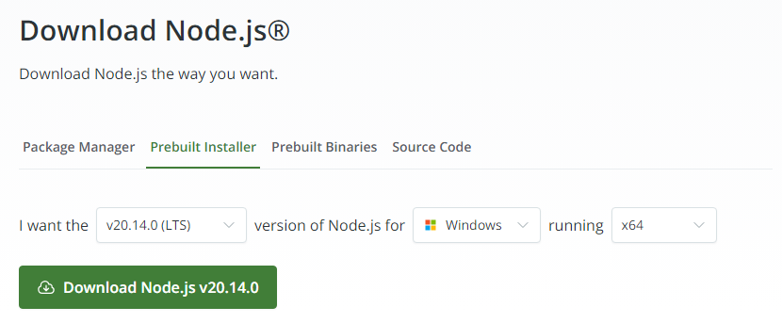
https://nodejs.org/en/download/prebuilt-installer

Slide 9
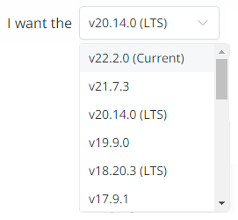
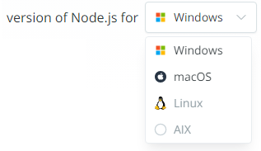
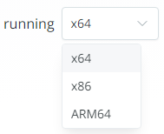

https://nodejs.org/en/download/prebuilt-installer

Slide 10
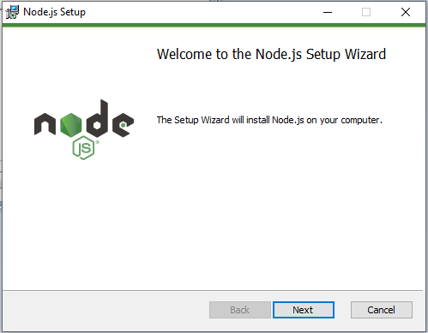

Slide 11
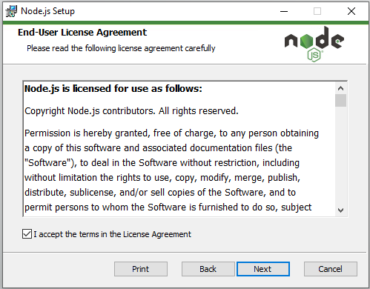

Slide 12
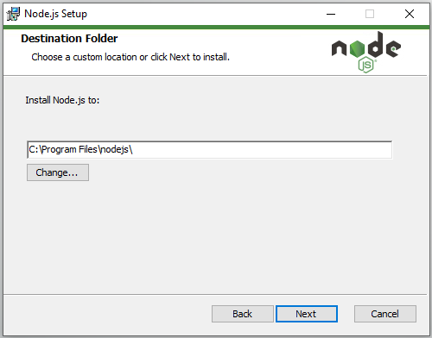

Slide 13
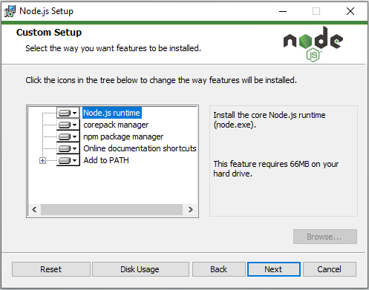

Slide 14
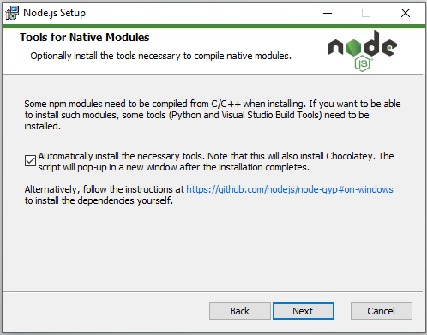

Slide 15
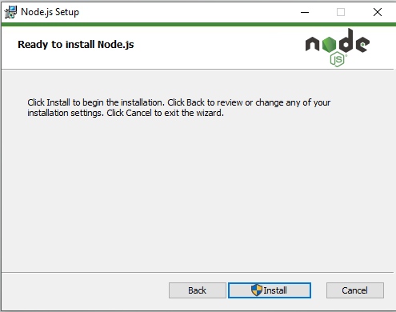

Slide 16
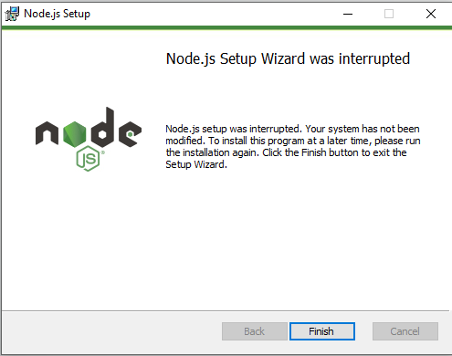

Slide 17
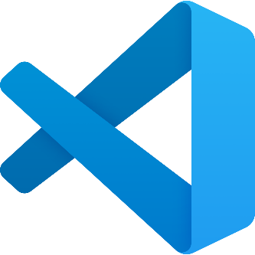
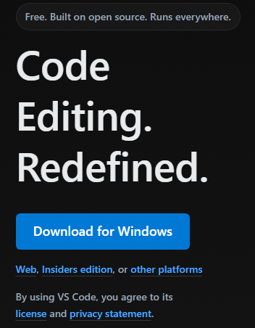


Verify Node.js installation using following command
in the terminal
Visual Studio Code
Download Visual Studio Code from Official Website
https://code.visualstudio.com/

Slide 18
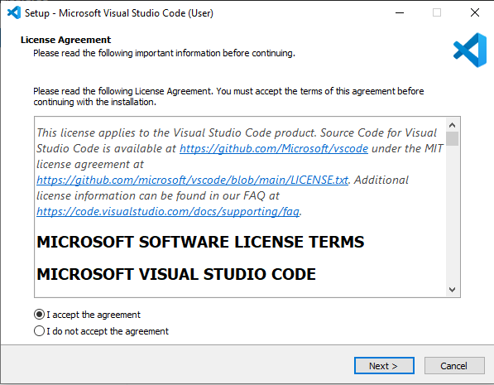

Slide 19
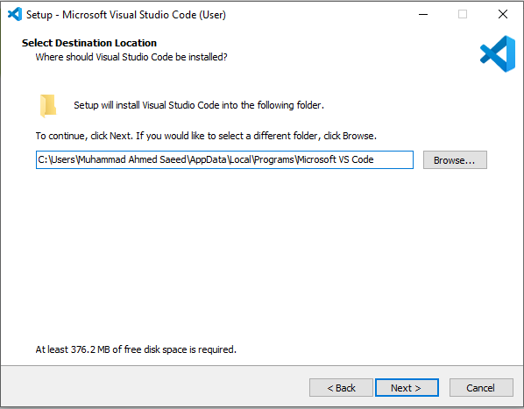

Slide 20
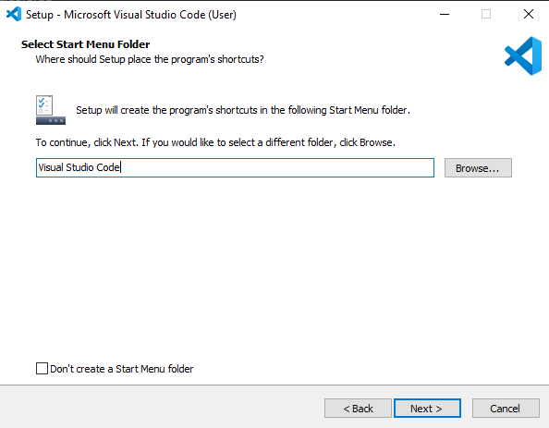

Slide 21
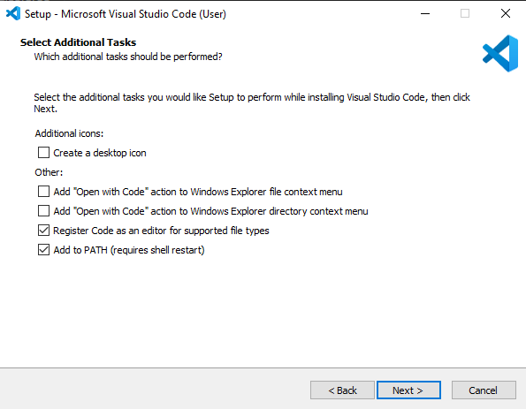

Slide 22
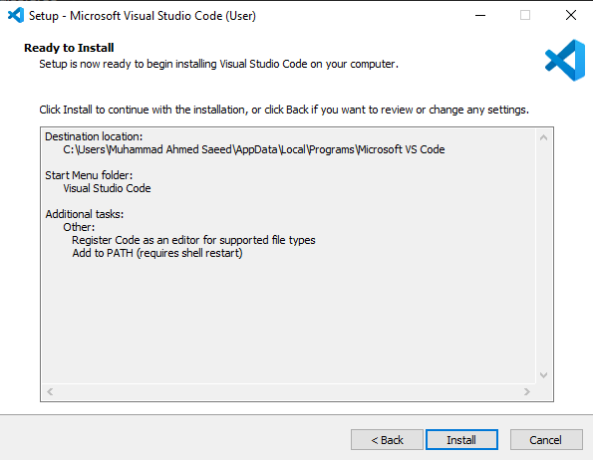

Slide 23
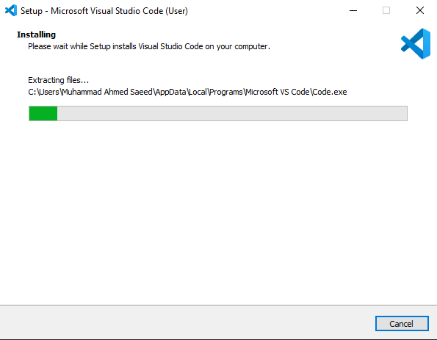

Slide 24
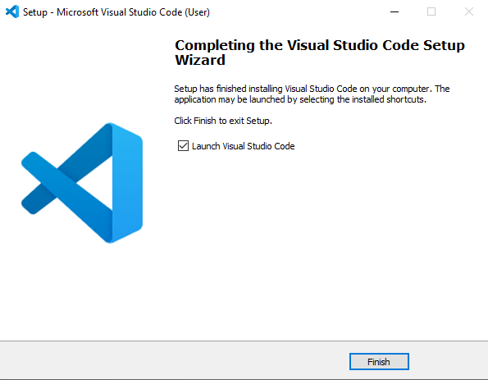

Slide 25


Create first node program
Output

